Slide 2
Basics of ML

Slide 3
Supervised/unsupervised

Slide 4
Classification/regression

Slide 5
Developing models from scratch
Training and testing

Slide 6
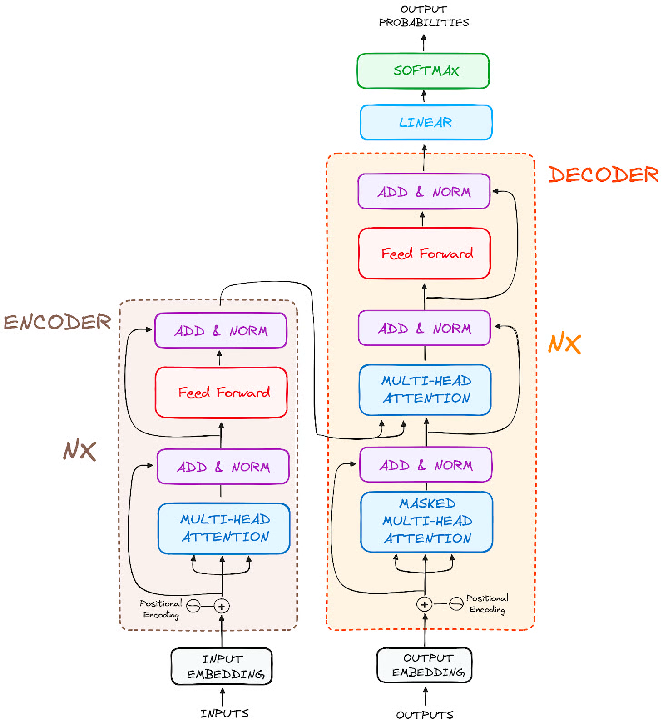
Transformers
Encoder:
input = sequence of text tokens
builds a representation of it (= its features)
trained to acquire understanding from the input.
Decoder:
uses the encoder's representation + other inputs (e.g. the previously predicted tokens)
generates a target sequence
trained to generate outputs.

Slide 7
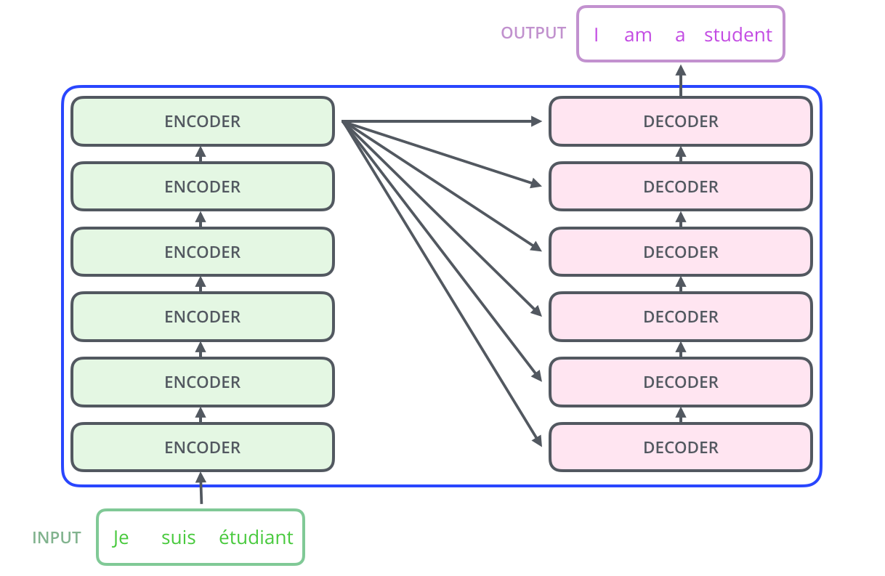
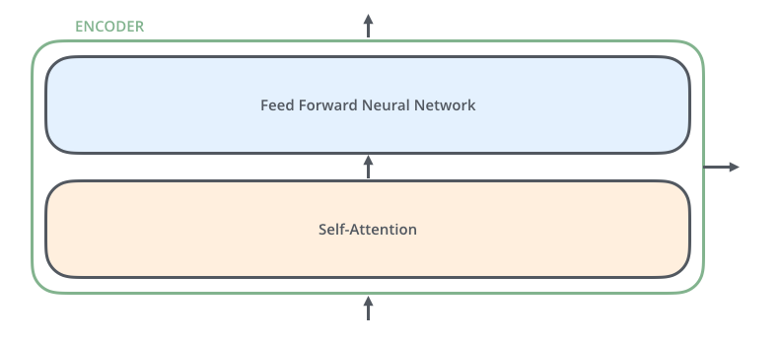
Main components
Encoder: processes the input data
Decoder: generates output sequences
Self-attention mechanism: helps models focus on relevant parts of the input
Positional Encoding: Importance in maintaining order in sequences.

Slide 8
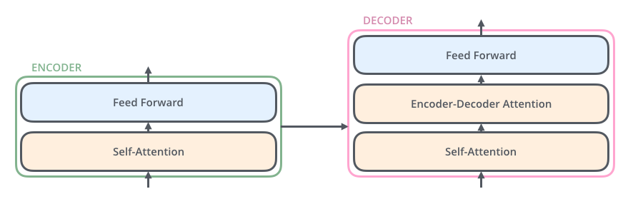

Slide 9
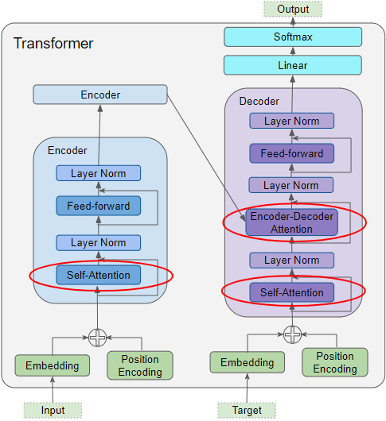

Slide 10
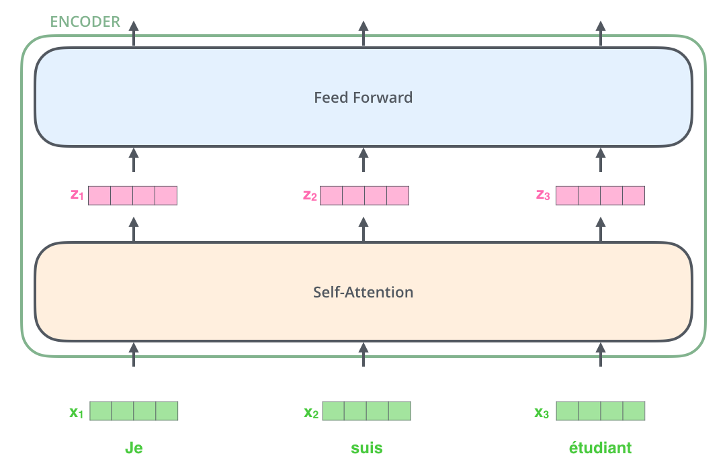

Slide 11
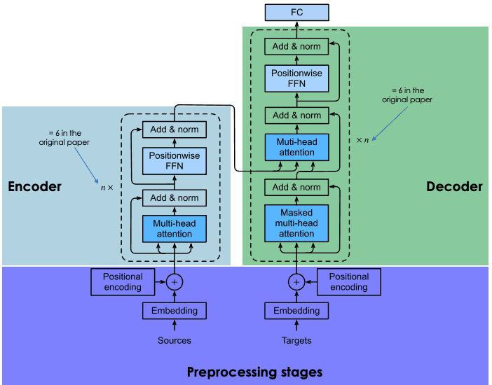
Preprocessing stage
Steps:
generation of the embeddings of the input sentence
computation of the positional vector of each word in the input sentence
Same way for the source sentence (before the encoder block) and the target sentence (before the decoder block).

Slide 12
Embedding of the input data
Steps:
tokenization
create the embedding of each individual word without paying attention to their relationship in the sentence

Slide 13
Positional encoding
Generate a context vector for each word.

Slide 14
Encoder block
Embeddings vector + its context vector= a single vector for each word
NO knowledge about the relations that existed in the input sentence

Slide 15
Multi-head attention
Attention: capture the contextual relationships existing between different words in the input sentence
Attention vector

Slide 16
Position-wise feed-forward net (FFN)
a feed-forward neural network applied to every attention vector to transform them into a format that is expected by the next multi-head attention layer in the decoder

Slide 17
Decoder block
Layers:
masked multi-head attention
multi-head attention (same as in encoder)
a position-wise feed-forward network (same as in encoder)

Slide 18
Multi-head attention layer
Splits the input into multiple smaller parts (=heads) and applies attention separately to each.
Each head independently attends to different parts of the input and captures various relationships or contexts.
The results from all heads are then combined, providing the model with a richer understanding of the input.
Benefits:
Captures Diverse Patterns
Increases Model Capacity:

Slide 19
Transfer Learning
Training from scratch is too expensive (training time)
The amount of data is not accessible
E.g. translation from one rare language to another
Solution: re-use available models
Choose the pre-trained model that is similar to your use case
Refining the input-output pair data of your target task,
Retraining the head of the pre-trained model by using your data.

Slide 20
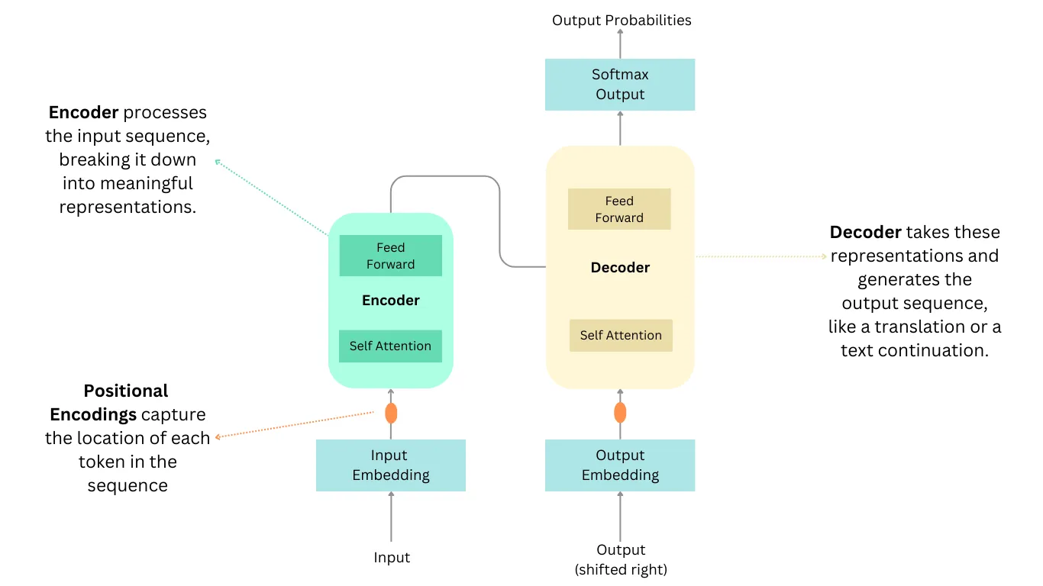

Slide 21
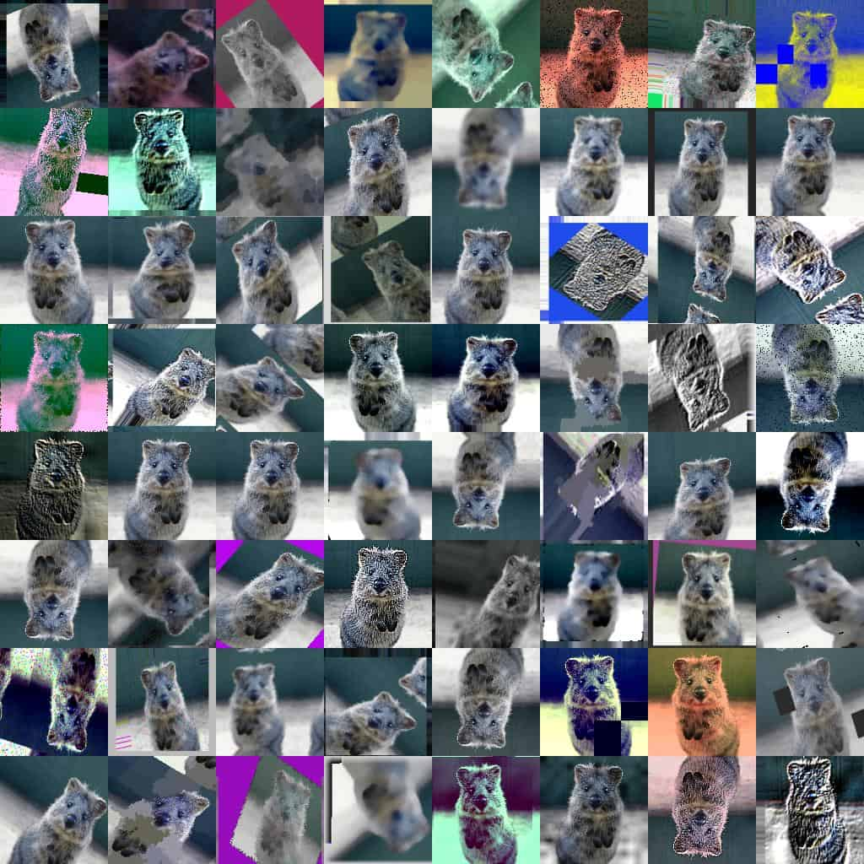
From text to images
Challenges of working with images

Slide 22
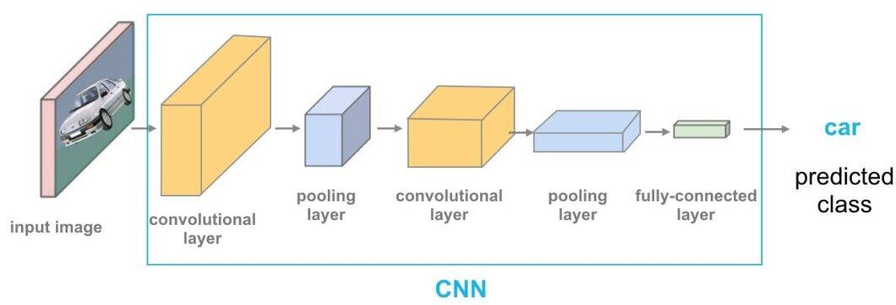
Convolutional Neural Networks (CNNs)

Slide 23
ViT

Slide 24
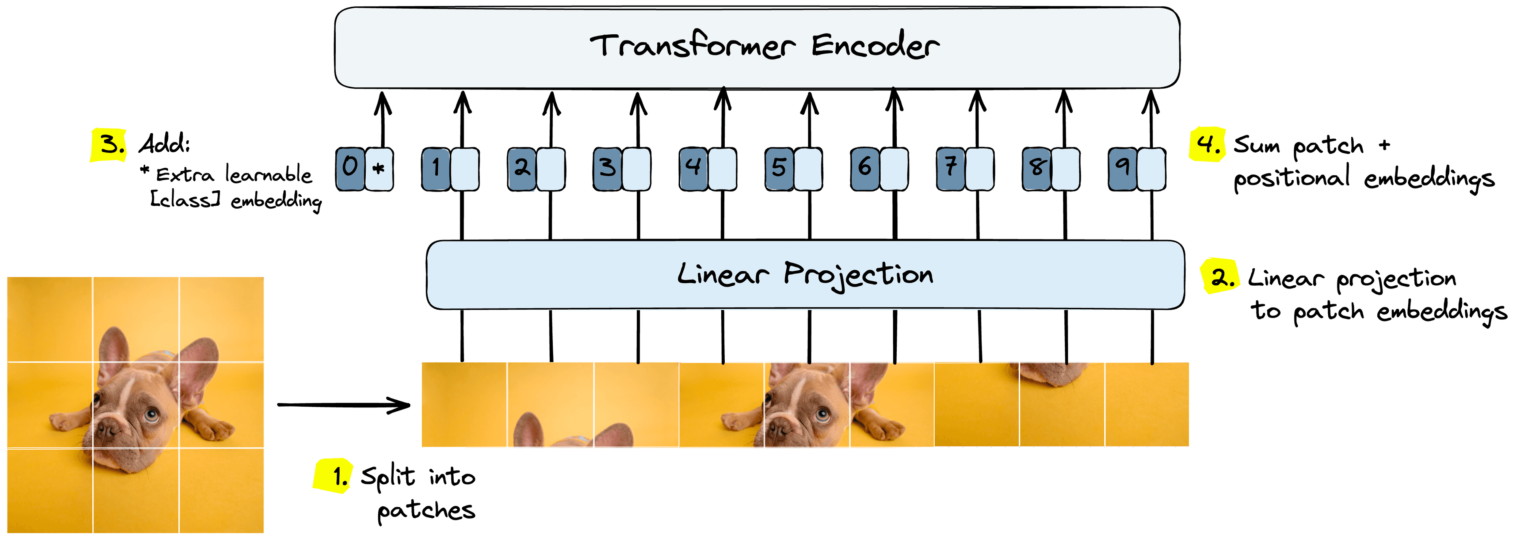
Image to patch embeddings
Split the image into image patches.
Process patches through the linear projection layer to get initial patch embeddings.
Preappend trainable “class” embedding to patch embeddings.
Sum patch embeddings and learned positional embeddings.

Slide 25
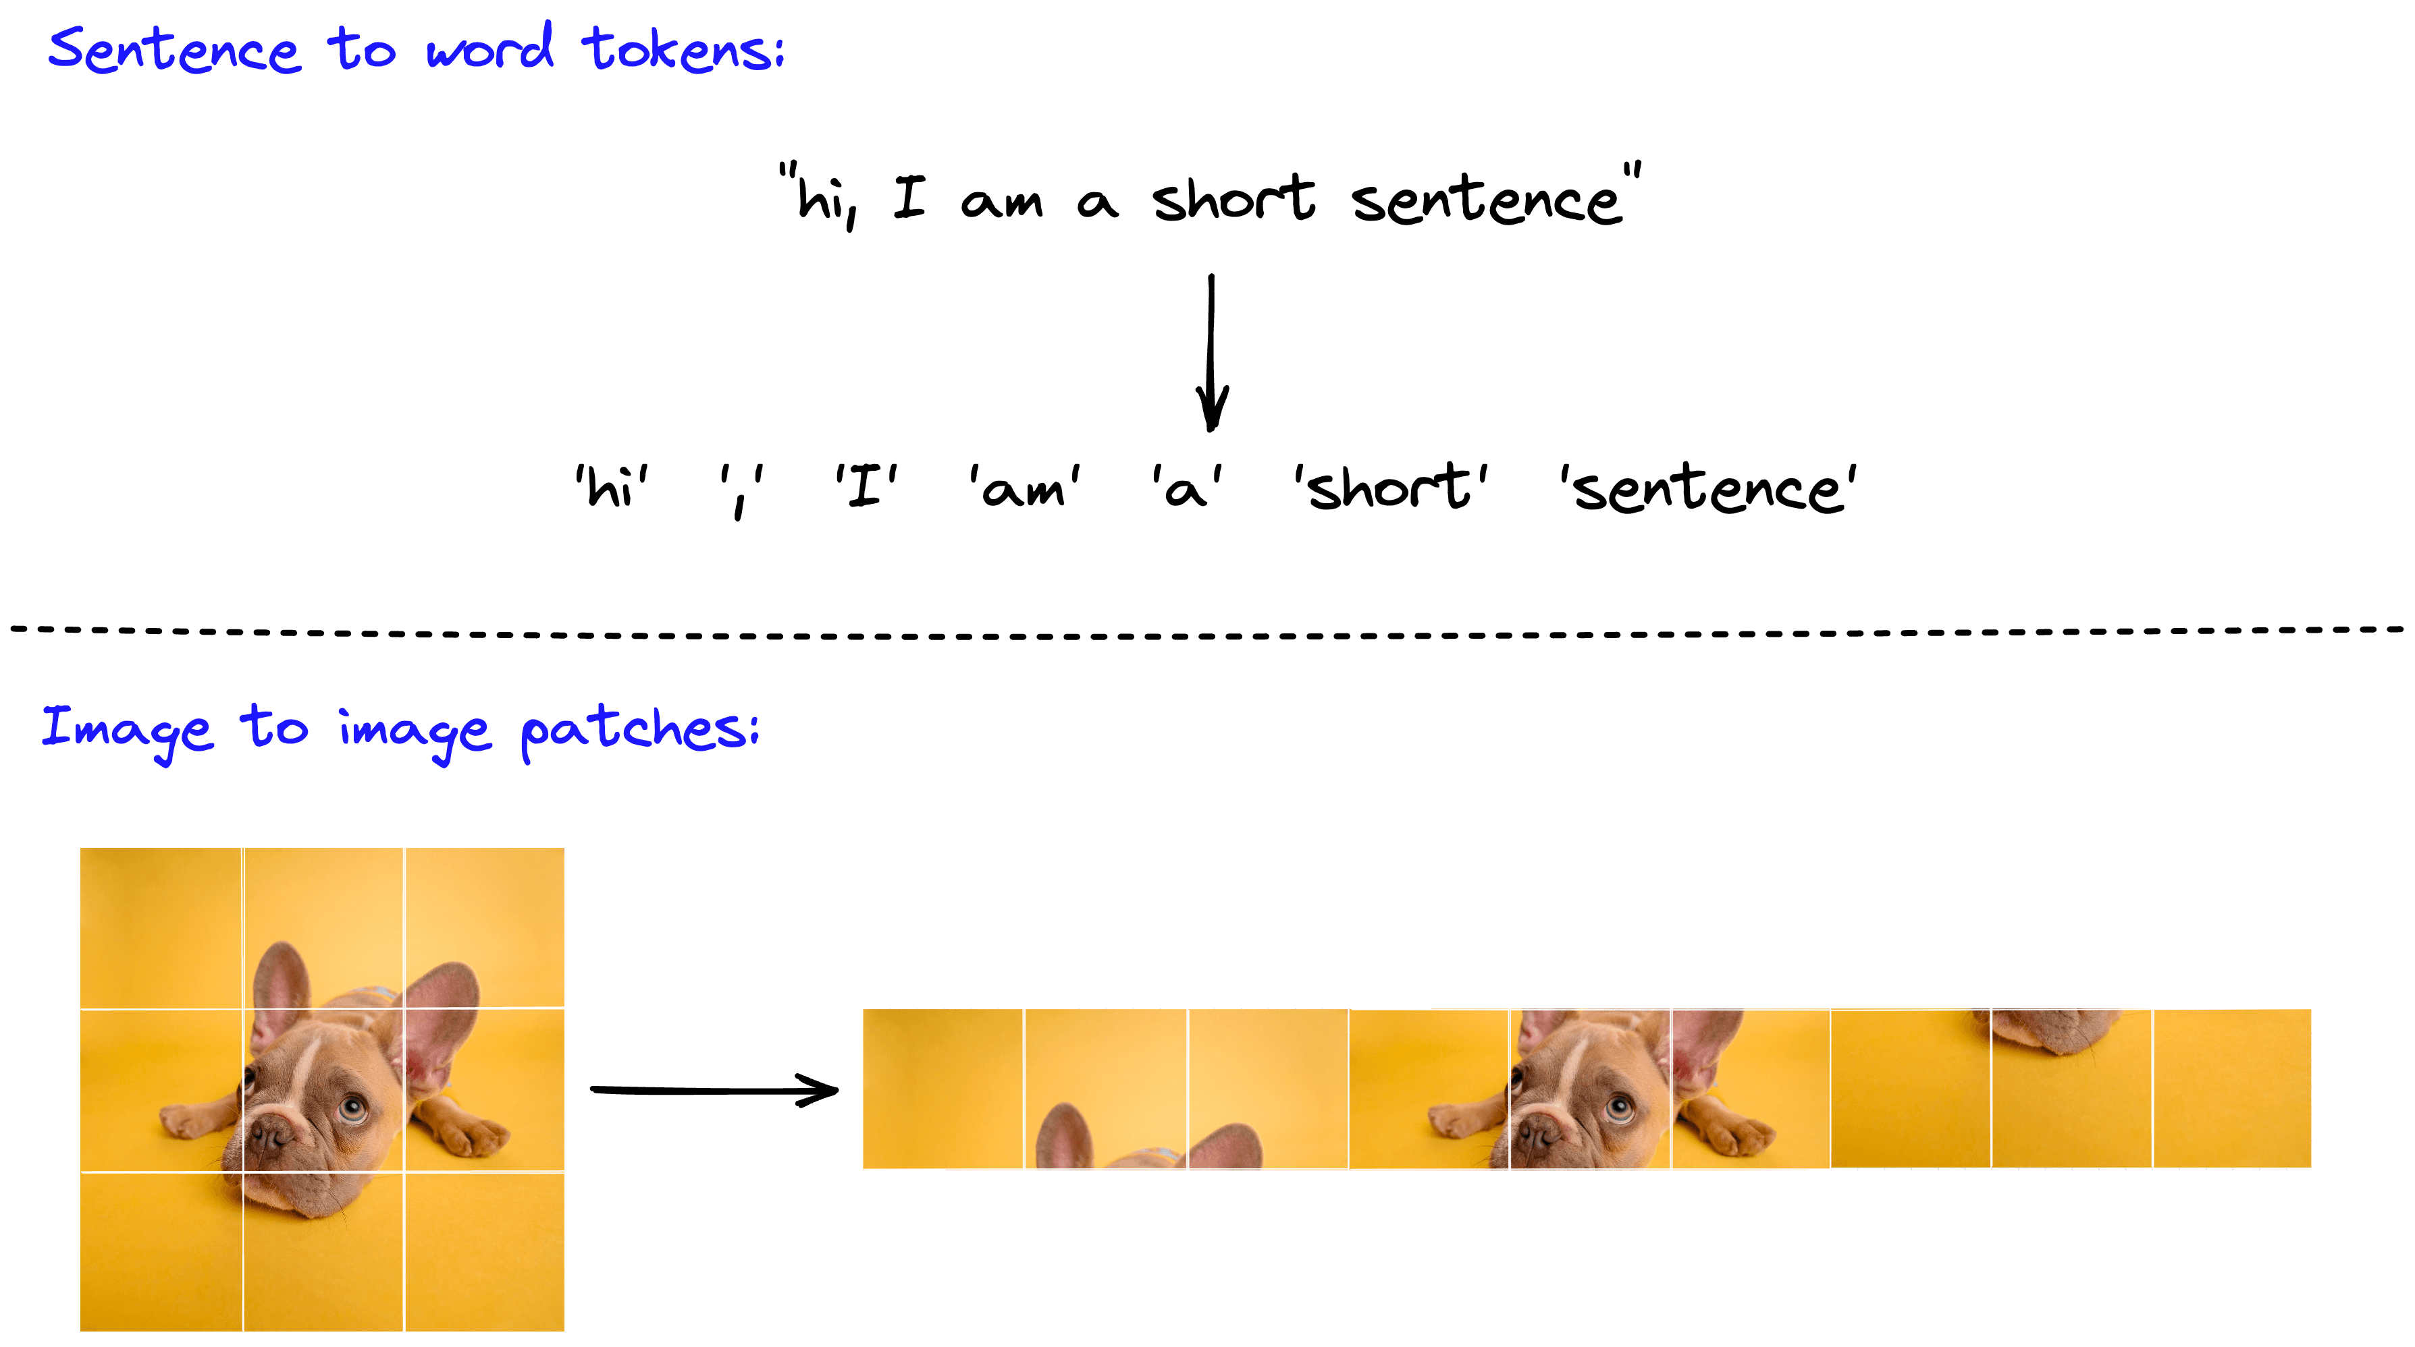
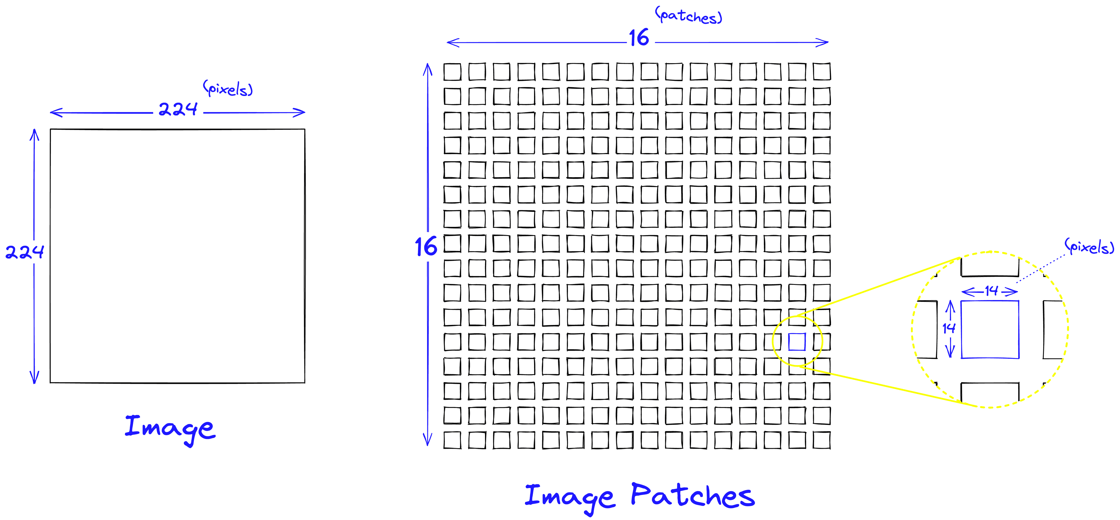
Image to patch embeddings
Attention requires the comparison of every input to all other inputs.
If we perform that on a 224x224 pixel image, we must perform 22442244 (2.5E92.5E9) comparisons. That’s for a single attention layer, of which transformers contain several.

Slide 26
Image to patch embeddings
- Attention requires the comparison of every input to all other inputs.
- If we perform that on a 224x224 pixel image, we must perform 22442244 (2.5E92.5E9) comparisons per layer * number of layers

Slide 27
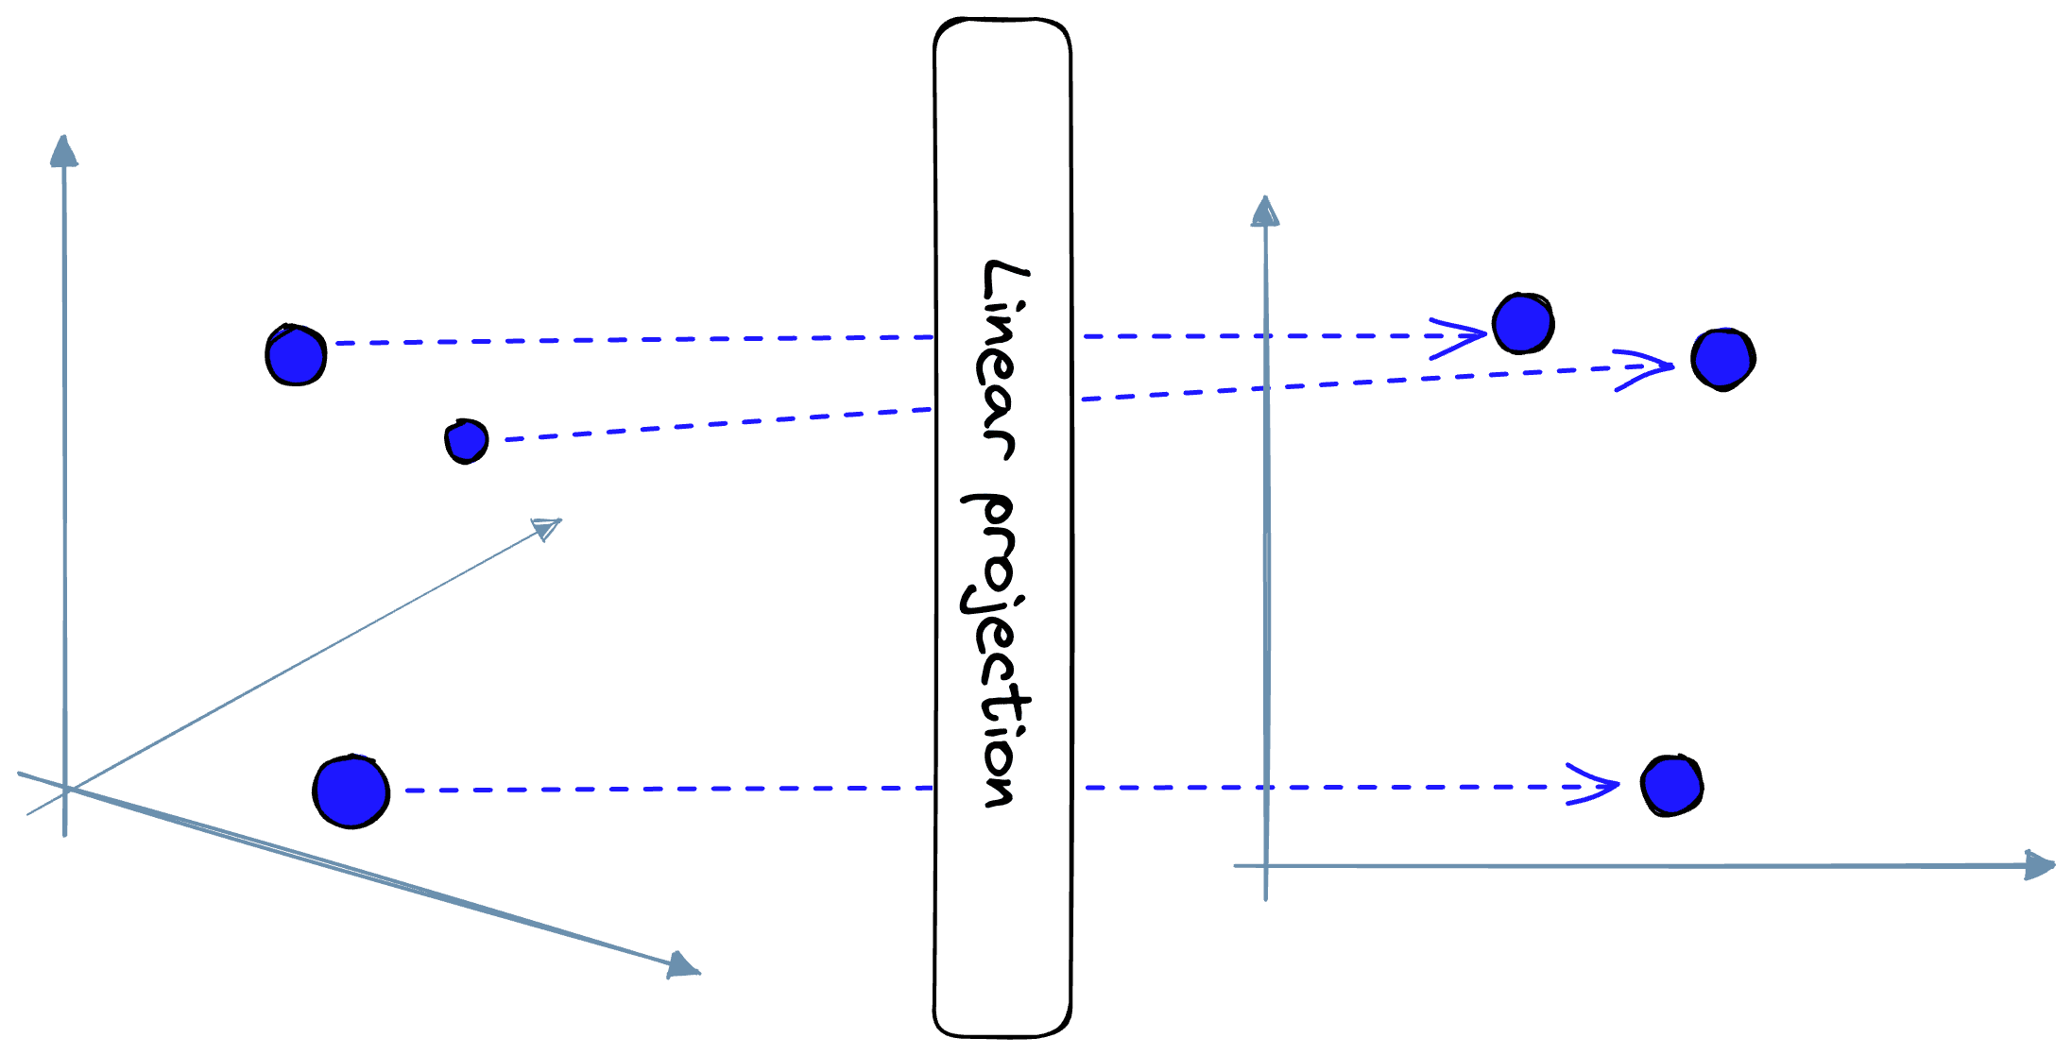
Linear Projection
A linear projection layer maps the image patch “arrays” to patch embedding “vectors”.

Slide 28
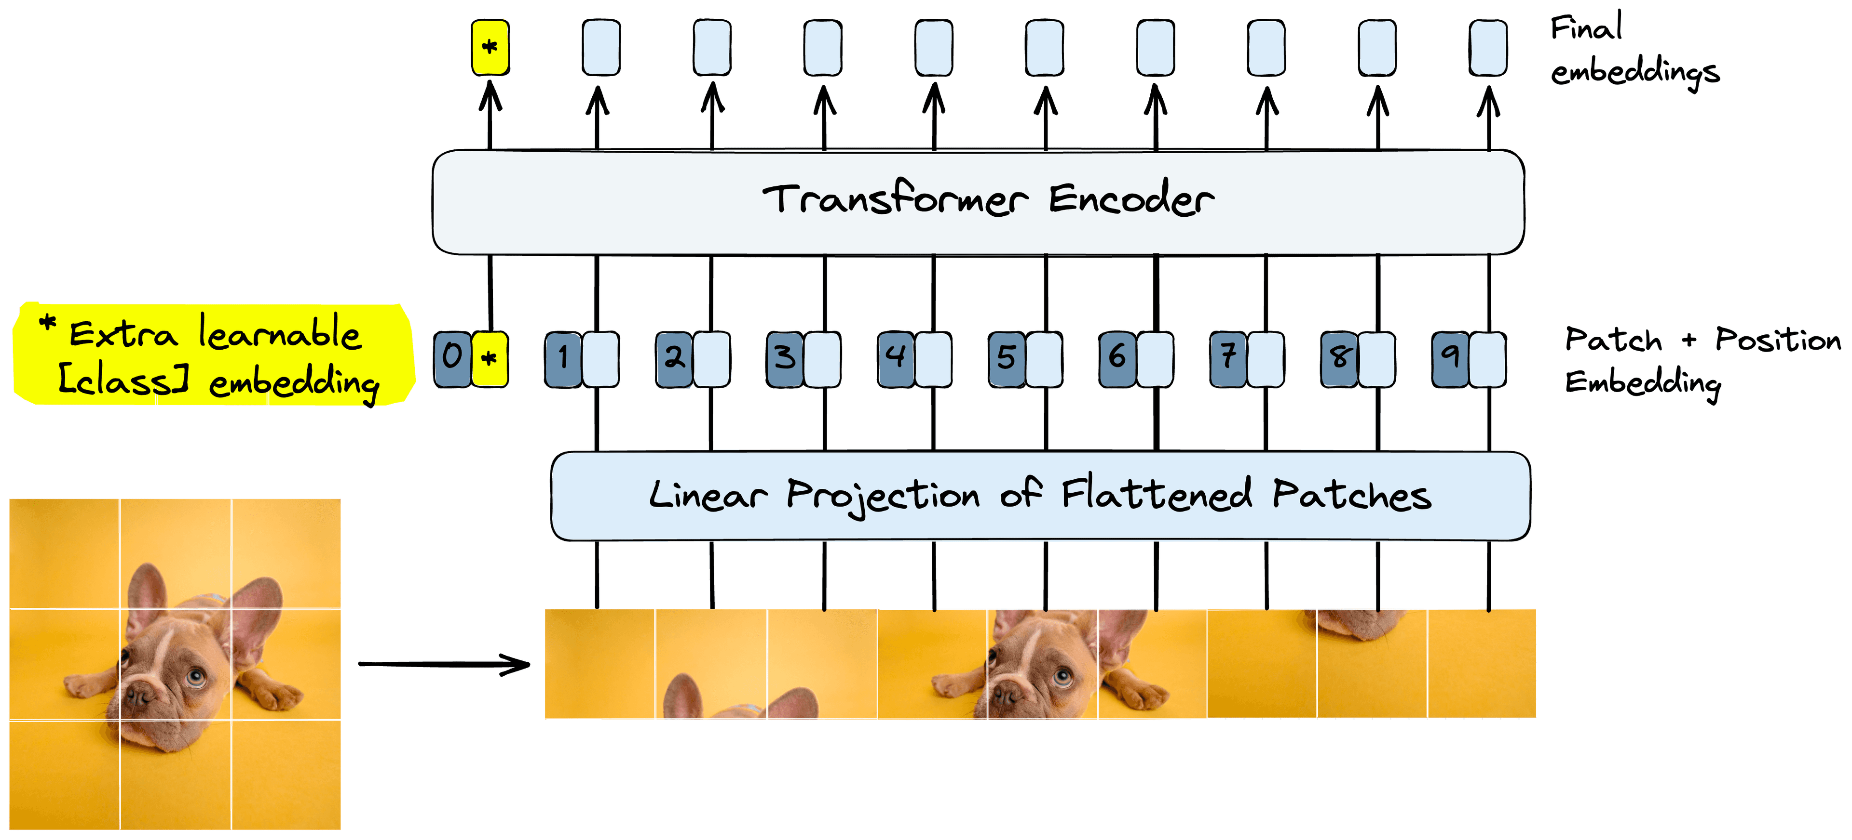
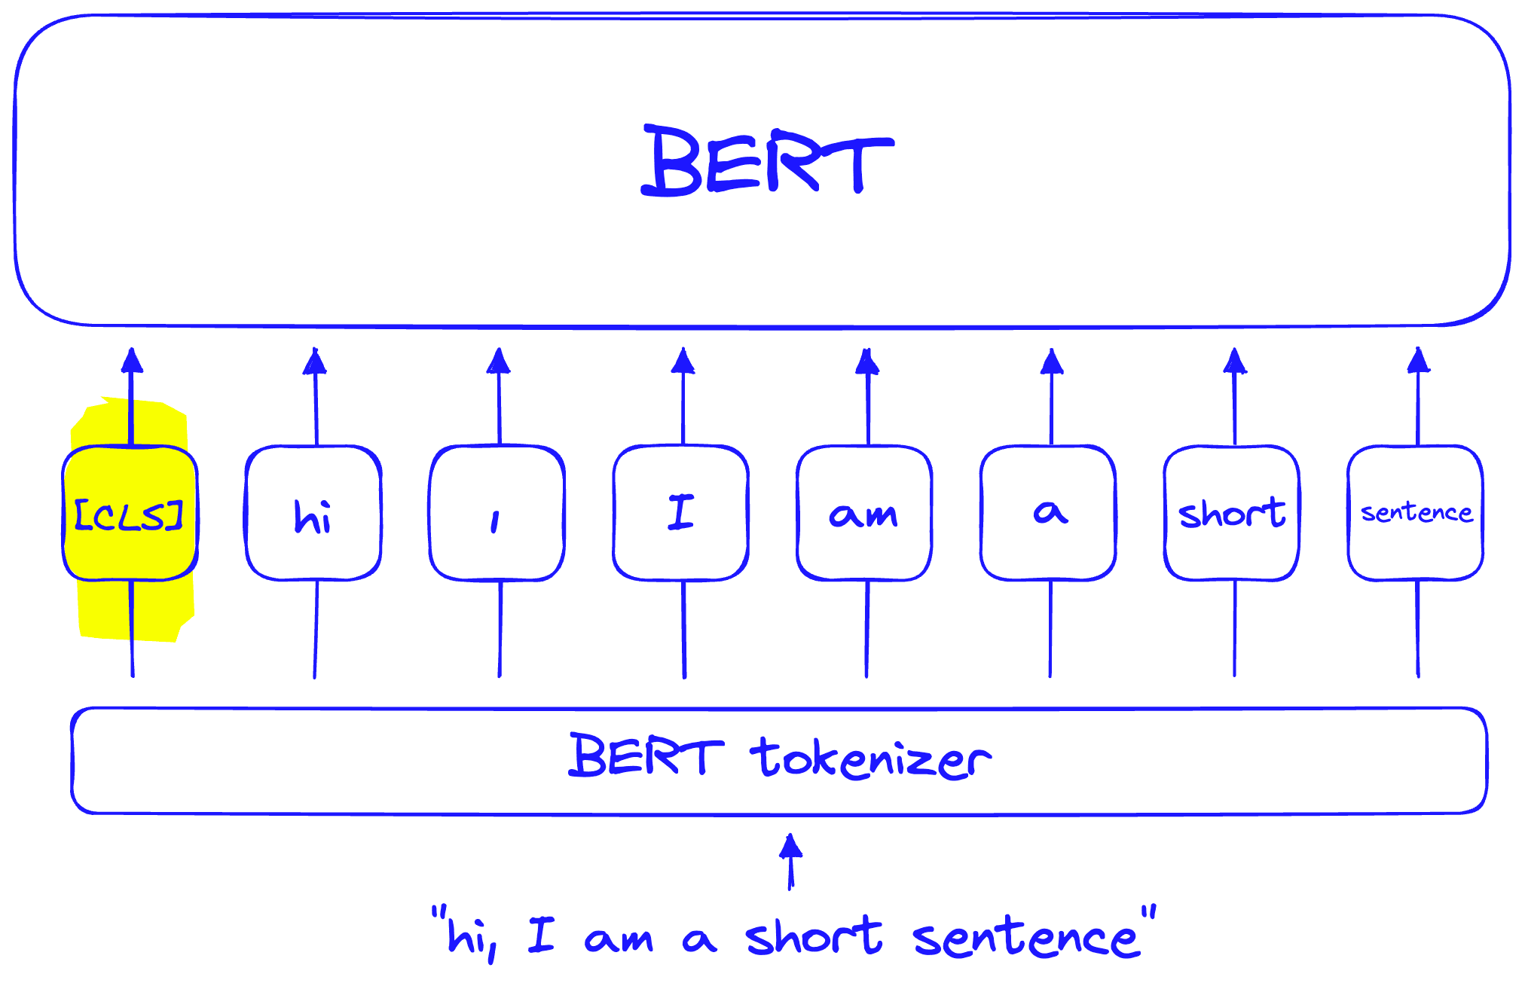
Learnable Embeddings in ViT

Slide 29
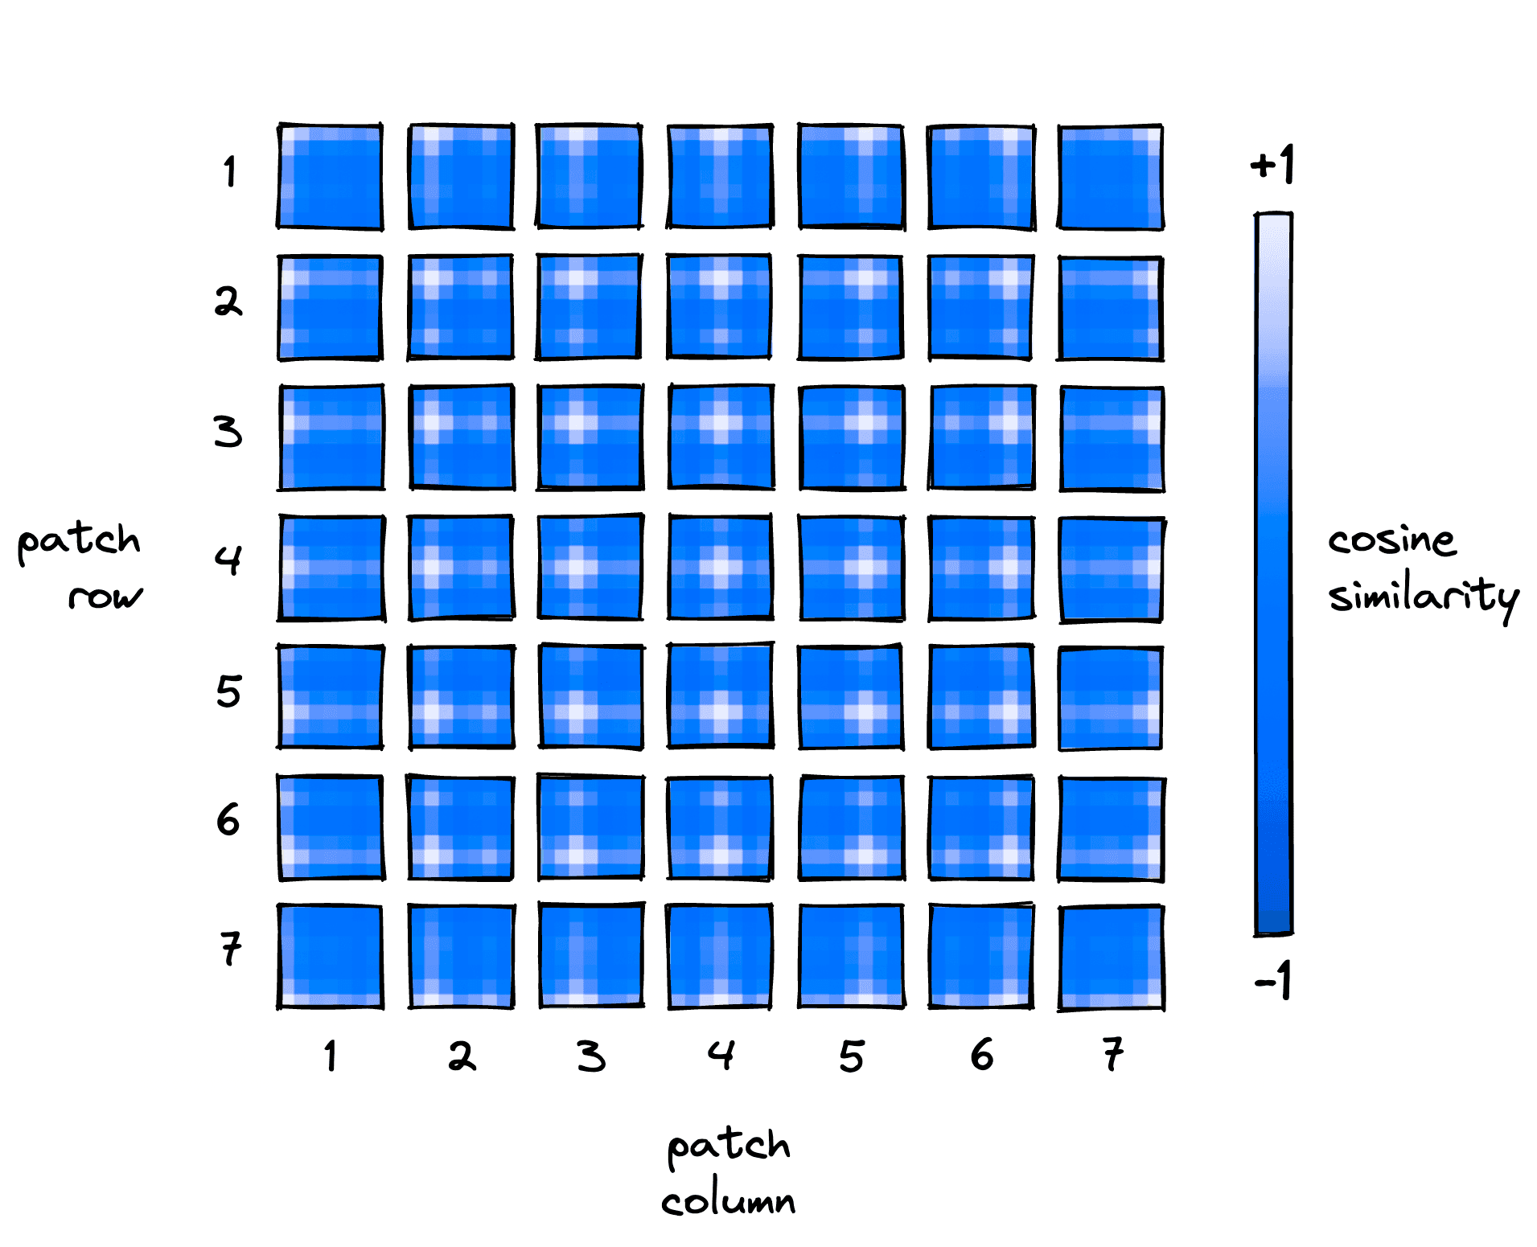
Positional Embeddings with Images
Positional embeddings are added to patch embeddings and the “class” embedding

Slide 30
Image patching in ViT demo

Slide 31
Working with images workflow

Slide 32
ViT dataset

Slide 33
Image data: folder with images + text/meta/

Slide 34
Data preprocessing: steps and why

Slide 35
ViT major models and difference

Slide 36
Evaluation for image related tasks

Slide 37
Improving results with fine-tuning
Full finetuning
LoRa
PEFT

Slide 38
HF: Trainer and Training arguments

Slide 39
Image classification

Slide 40
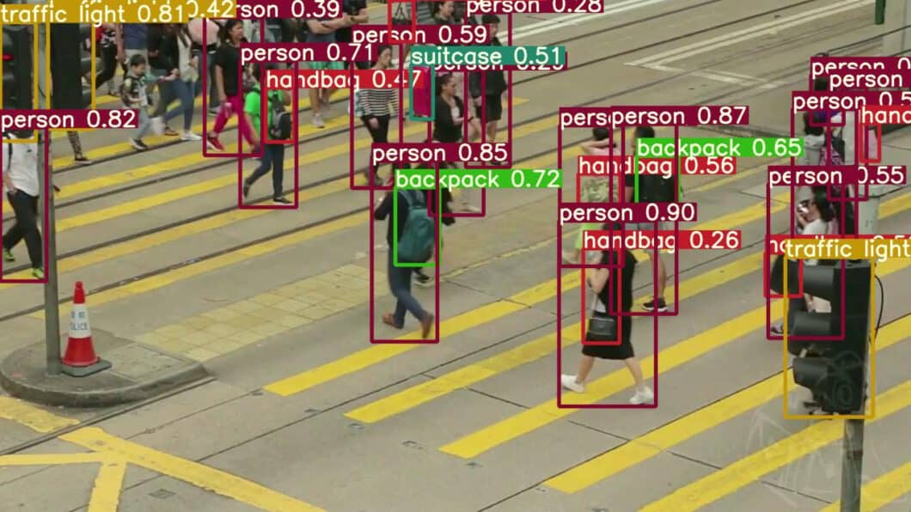
Object detection

Slide 41
Image captioning

Slide 42
Common metrics: ROUGE
ROUGE (Recall-Oriented Understudy for Gisting Evaluation) is a family of metrics for automatic summary evaluation that measures overlap between a system summary and one or more reference summaries.
Core idea: compare n-grams, longest common subsequence, or skip-bigrams between system and references.
Variants you’ll see most:
ROUGE-1 / ROUGE-2: unigram / bigram overlap.
ROUGE-L: longest common subsequence (captures in-order matches without being strictly contiguous).
(Less common) ROUGE-S/SU: skip-bigram variants.
Scores: typically report Recall, Precision, and F1 (0–1 or %). Higher is better. Many papers emphasize Recall for summarization.
Multiple references: overlap is computed against each reference and aggregated (max/mean), which improves robustness.
Preprocessing tips: lowercase, strip punctuation, optional stemming/stop-word handling; keep the tokenizer/settings fixed across systems for fair comparison.
Use cases: news/meeting summarization, headline generation; sometimes used as a proxy in training (e.g., RL with ROUGE reward).
Limitations: surface-form metric—doesn’t understand synonyms/paraphrases, can favor extractive summaries, and is length-sensitive. For semantic fidelity, complement with BERTScore, BLEURT, or human eval.
https://huggingface.co/spaces/evaluate-metric/rouge

Slide 43
Common metrics: WER
https://huggingface.co/spaces/evaluate-metric/wer

